Slide 1
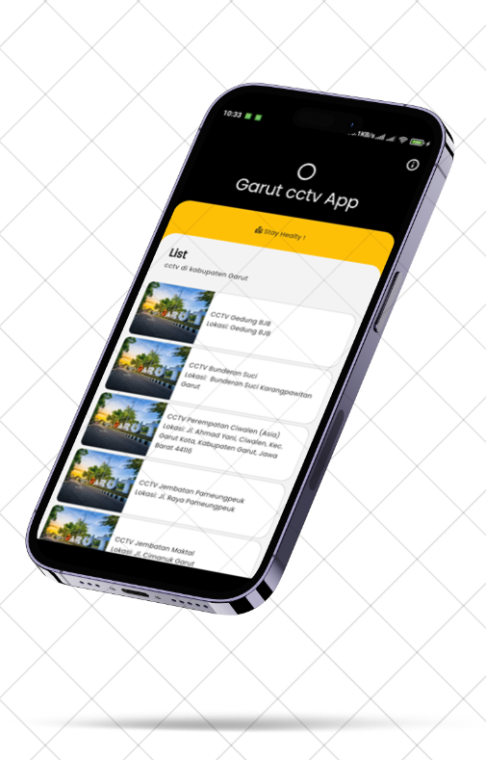

INSTITUT TEKNOLOGI GARUT
GARUT
CCTV APPLICATION
01
Pemrograman Mobile ( flutter )

Slide 2
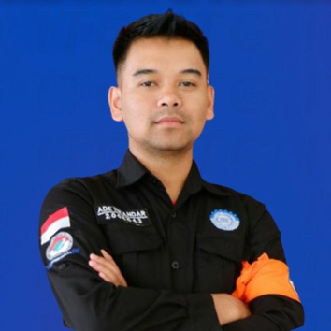
What are people saying about the brand
02
Abdul Latif
Ulpah Masripah
Ade Iskandar Zulkarnaen
Ui/Ux Designer
Flutter Enthusiast
Backend Developer
Presentations are communication tools that can be used as demonstrations, lectures, and more.
Presentations are communication tools that can be used as demonstrations, lectures, and more.
Presentations are communication tools that can be used as demonstrations, lectures, and more.

Slide 3
GARUT CCTV APPLICATION
03
Table of Contents
Introduction
Brand Launch
Marketing Channels
Q2 Sales
System Design
API Source
Source Code
QnA
Presentation Outline

Slide 4
MVC - SOURCE CODE
Isi ppt disini
4

Slide 5
MVC - SOURCE CODE
Isi ppt disini
5

Slide 6


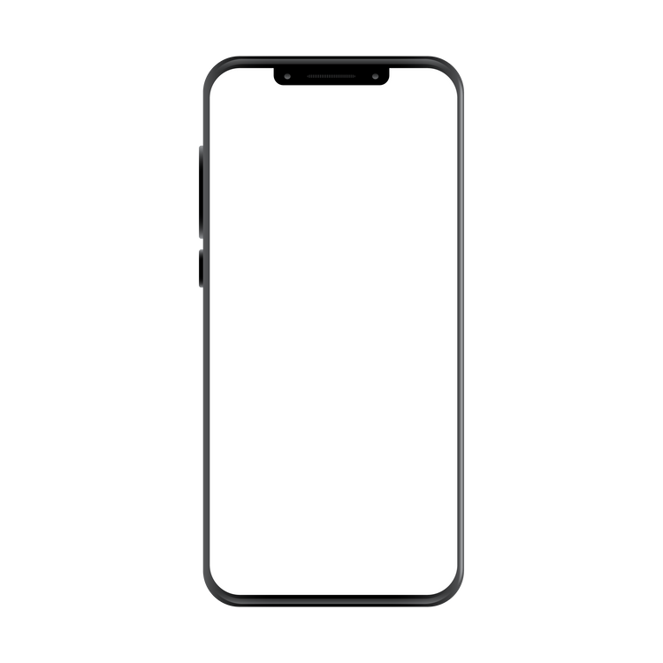
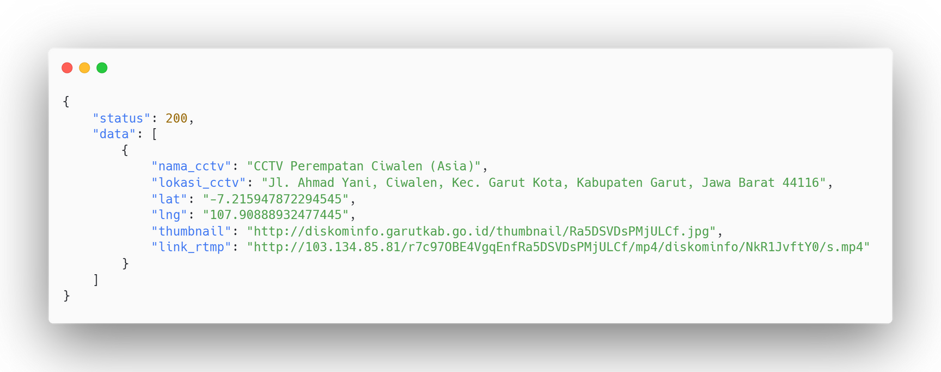
System Design
rest API pemerintah kabupaten Garut
database
GET
request
JSON
response
client

Slide 7
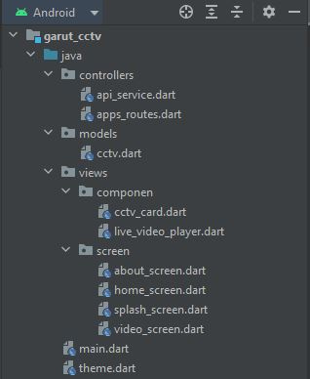
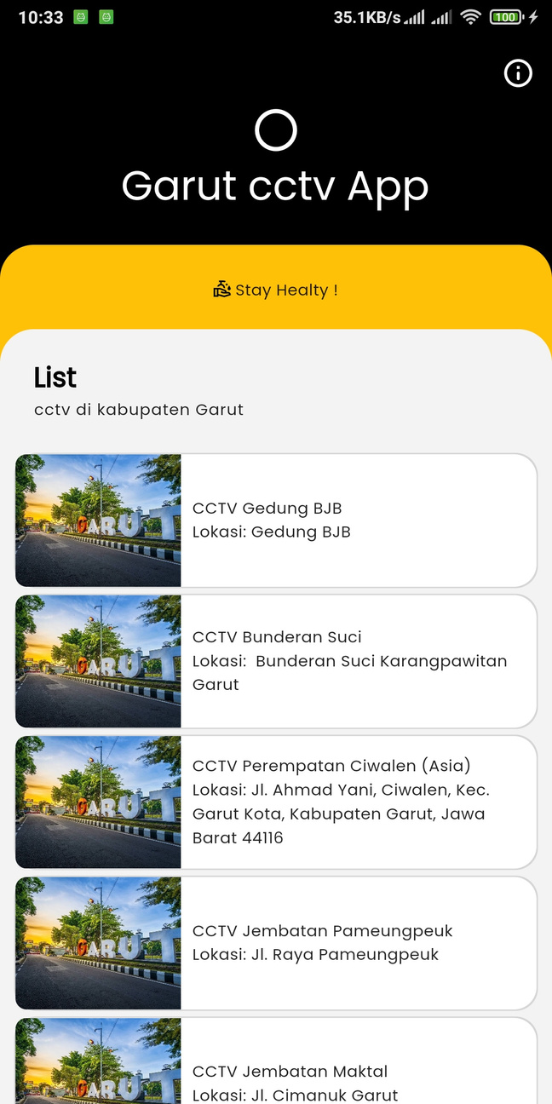
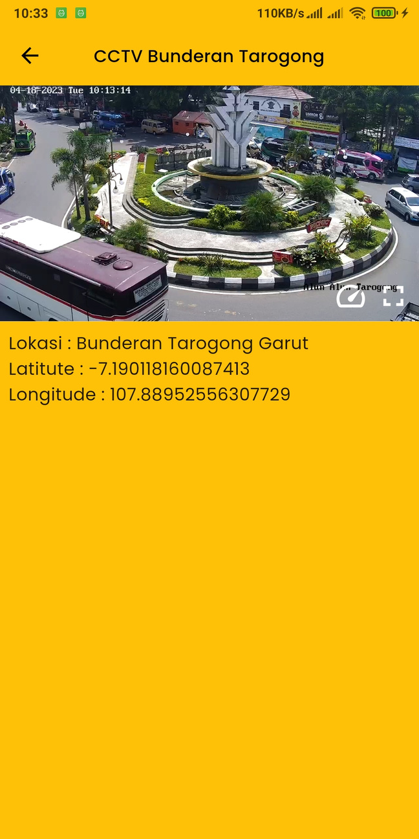
MVC - SOURCE CODE
95

Slide 8
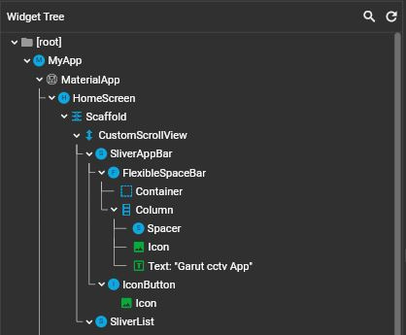
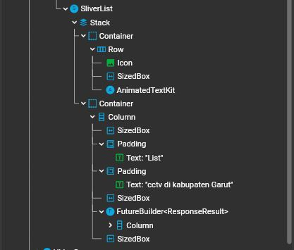
HOME SCREEN
96

Slide 9
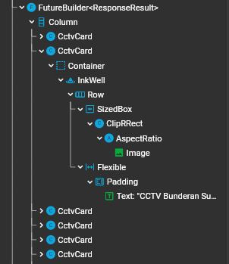
FUTHURE BUILDER - HOME SCREEN
97

Slide 10
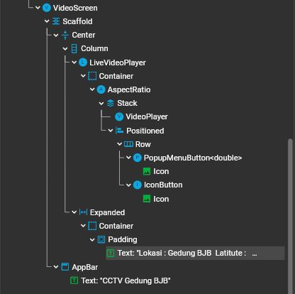
VIDEO SCREEN
98
...

Slide 11
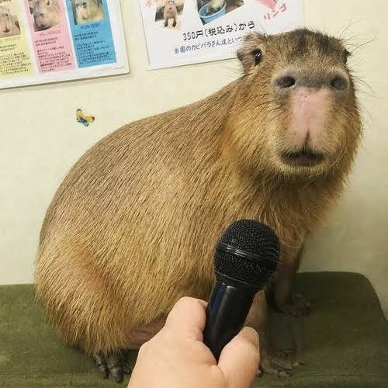
d
99
ADA PERTANYAAN MASBRO ???

